Slide 1
Corner-Based Estimation of Tire Forces
Corner-Based Estimation of Tire Forces and Vehicle Velocities Robust to Road Conditions (2017)
Ehsan Hashemi, Mohammad Pirani, Amir Khajepour, Alireza Kasaiezadeh, Shih-Ken Chen, Bakhtiar Litkouhi
Presented by: Brian Mao
Prepared for: Stephen Smith
ECE 686: Filtering and Control of Stochastic Linear Systems

Slide 2
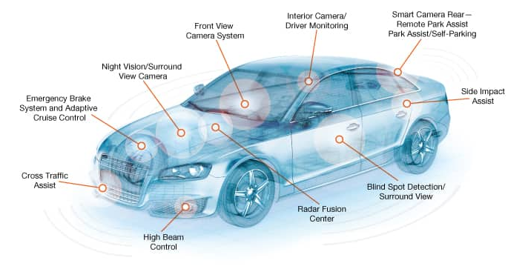
Vehicle Control Systems
Makes Driving Safer and Easier
Required for Fully Autonomous Driving
Other Examples:
Anti-Lock Braking System
Active Steering
Differential Braking

Slide 3
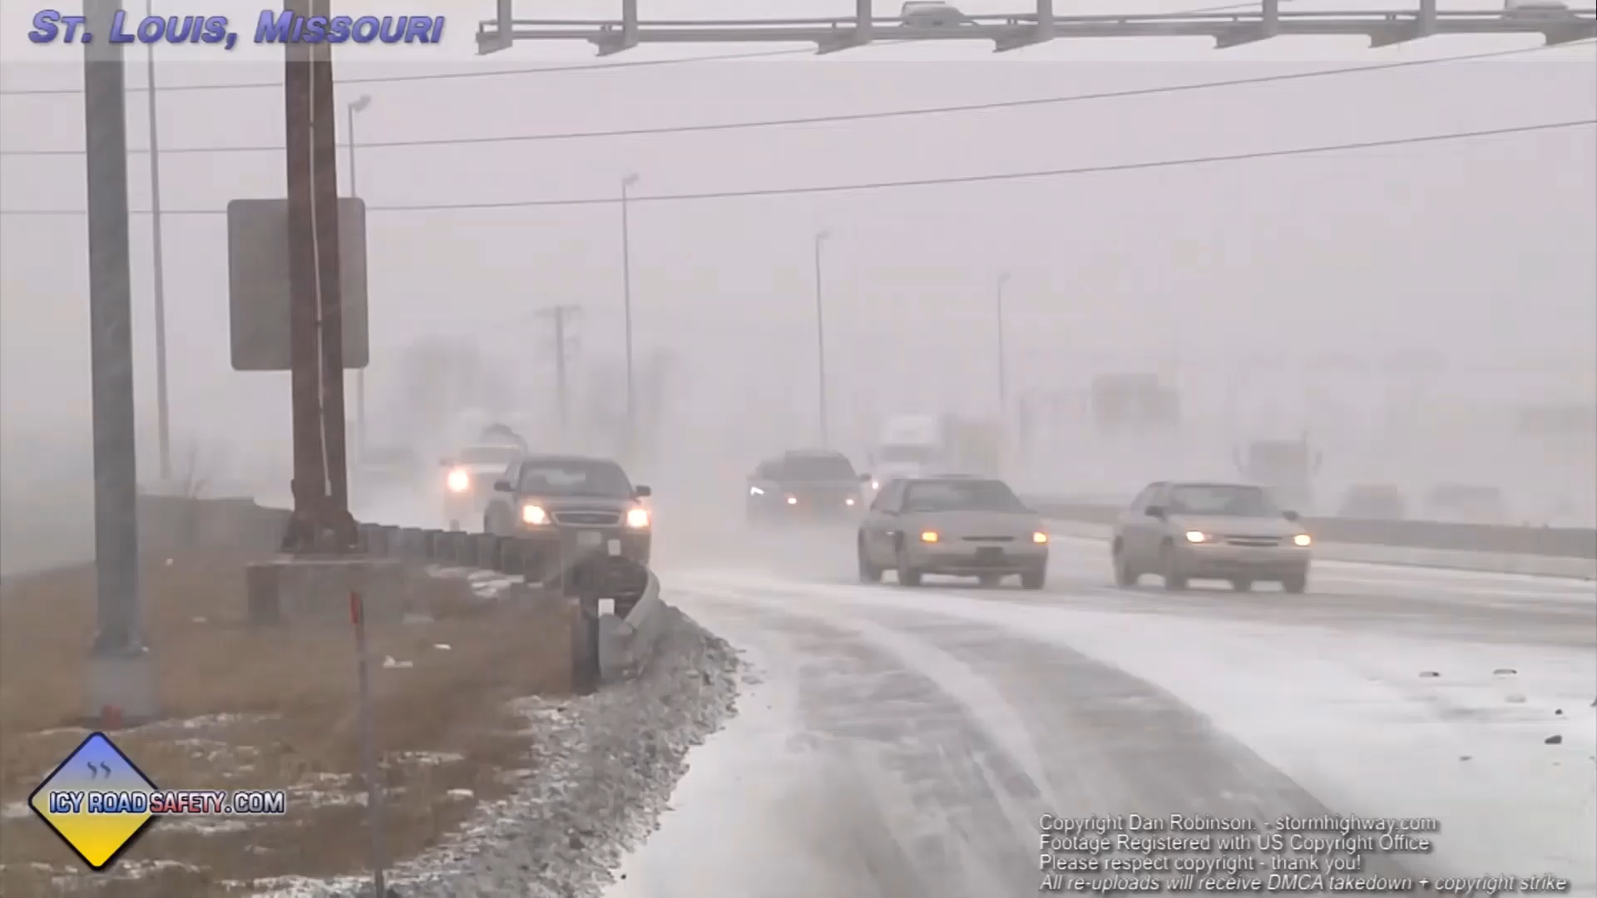
Driving Under Poor Weather Conditions

Slide 4

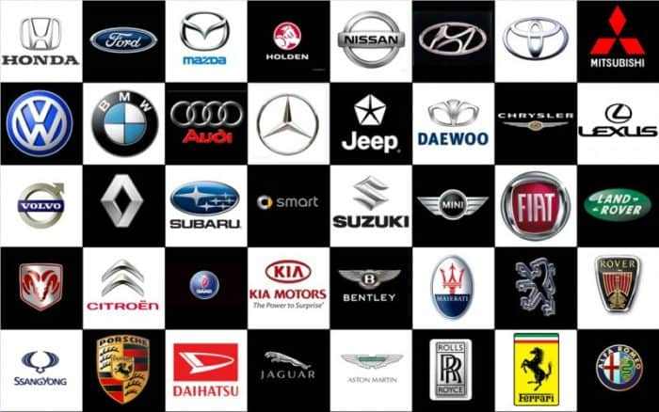
Controller Design
Problem:
Automotive companies currently spend a large amount of money and time to develop and tune controllers for new vehicles
Goal:
Reduce the development time for new vehicles by designing controllers that are universal to any vehicle configuration

Slide 5
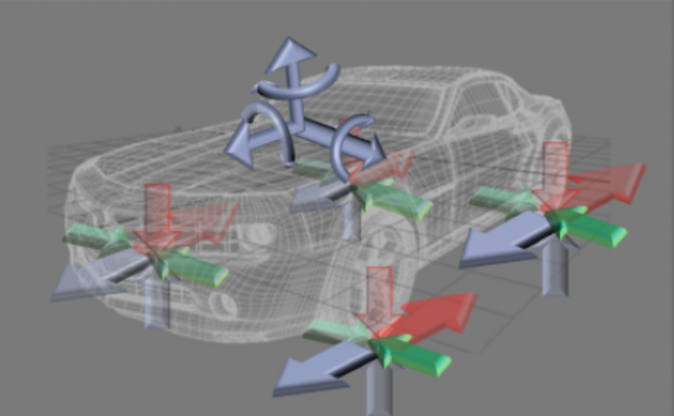
Corner-Based Estimation
Universal Estimation Approach
Direct Measurement is Impractical on Mass Production Vehicles

Slide 6
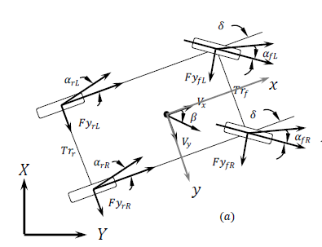
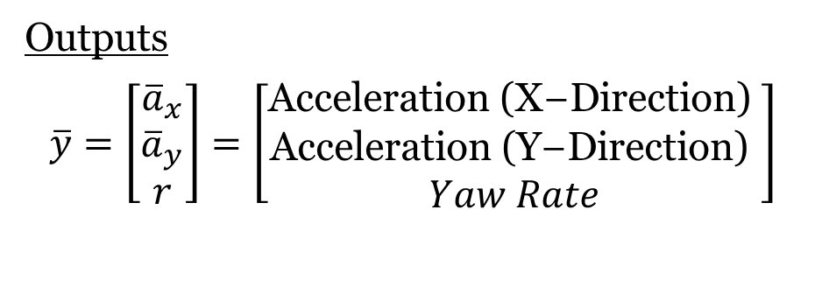
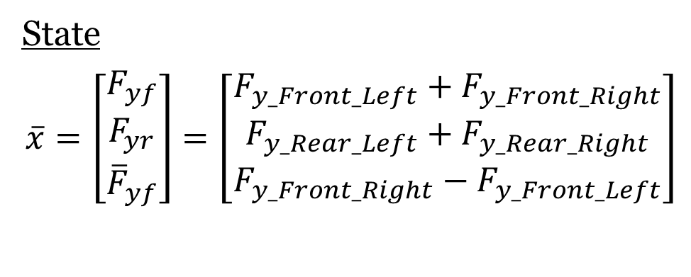
Lateral Force Estimation $(F_{y})$
Estimated using Unscented Kalman Filter (UKF)
State
$$\overline{x}=\left[\begin{matrix}F_{yf} \\ F_{yr} \\ {\overline{F}}_{yf}\end{matrix}\right]=\left[\begin{matrix}F_{y_Front_Left}+F_{y_Front_Right} \\ F_{y_Rear_Left}+F_{y_Rear_Right} \\ F_{y_Front_Right}−F_{y_Front_Left}\end{matrix}\right]$$
Outputs
$$\overline{y}=\left[\begin{matrix}{\overline{a}}_{x} \\ {\overline{a}}_{y} \\ r\end{matrix}\right]=\left[\begin{matrix}\text{Acceleration}\text{ (}\text{X}\text{−}\text{Direction}\text{) } \\ \text{Acceleration}\text{ (}\text{Y}\text{−}\text{Direction}\text{) } \\ Yaw Rate\end{matrix}\right]$$

Slide 7
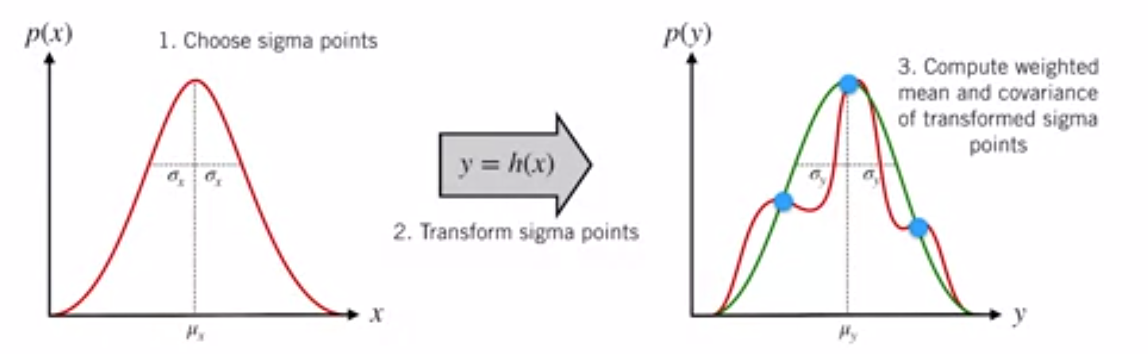
Unscented Kalman Filter (UKF)
Main Idea: It is easier to approximate a probability distribution compared to a nonlinear function
An unscented transform is a function that estimates the result of applying a non-linear function on a probability density function given a finite set of samples
Greater accuracy than an Extended Kalman Filter (EKF) for highly non-linear systems

Slide 8
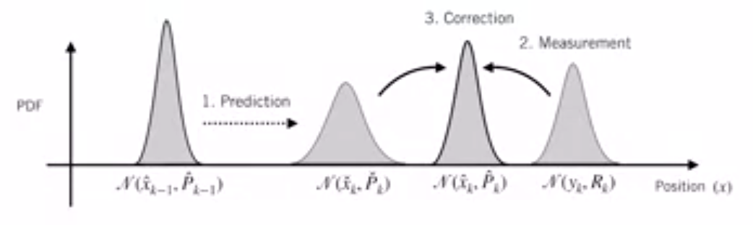
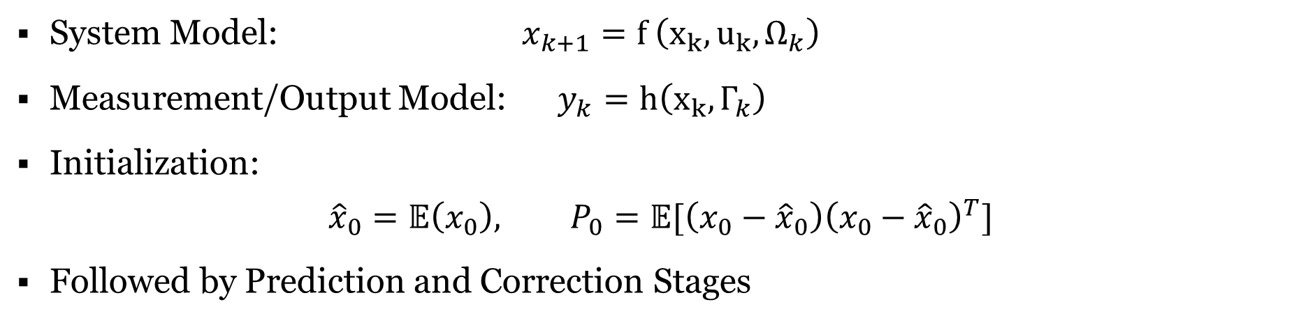
Overview
System Model: $x_{k+1}=f \left(x_{k},u_{k},Ω_{k}\right)$
Measurement/Output Model: $y_{k}=h\left(x_{k},Γ_{k}\right)$
Initialization:
$${\hat{x}}_{0}=𝔼\left(x_{0}\right), P_{0}=𝔼[\left(x_{0}−{\hat{x}}_{0}\right){\left(x_{0}−{\hat{x}}_{0}\right)}^{T}]$$
Followed by Prediction and Correction Stages

Slide 9
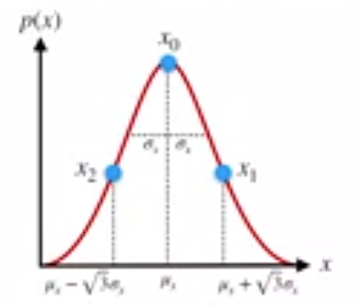
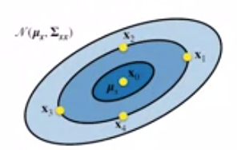
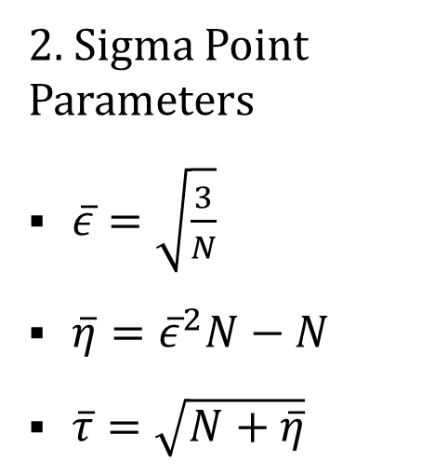
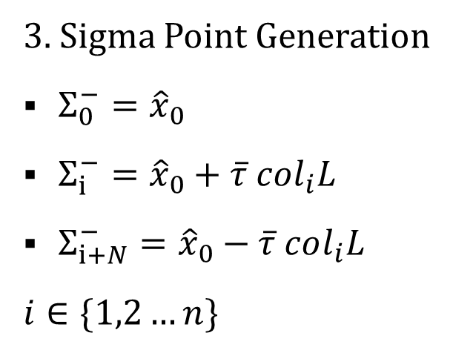
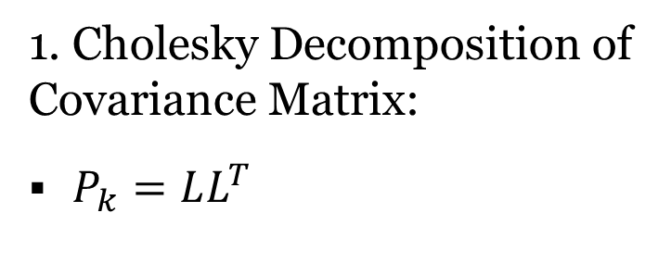
Prediction: Sigma Point Generation
Generate 2N+1 sigma points (where N = Length of State Vector)
1. Cholesky Decomposition of Covariance Matrix:
$P_{k}=LL^{T}$
2. Sigma Point Parameters
$\overline{ε}=\sqrt{\frac{3}{N}}$
$\overline{η}={\overline{ε}}^{2}N−N$
$\overline{τ}=\sqrt{N+\overline{η}}$
3. Sigma Point Generation
$Σ_{0}^{−}={\hat{x}}_{0}$
$Σ_{i}^{−}={\hat{x}}_{0}+\overline{τ} col_{i}L$
$Σ_{i+N}^{−}={\hat{x}}_{0}−\overline{τ} col_{i}L$
$i∈\{1,2…n\}$

Slide 10
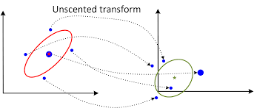
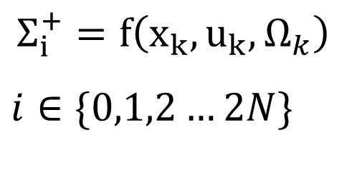
Prediction: Propagate Sigma Points
$$Σ_{i}^{+}=f\left(x_{k},u_{k},Ω_{k}\right)$$
$i∈\{0,1,2…2N\}$

Slide 11
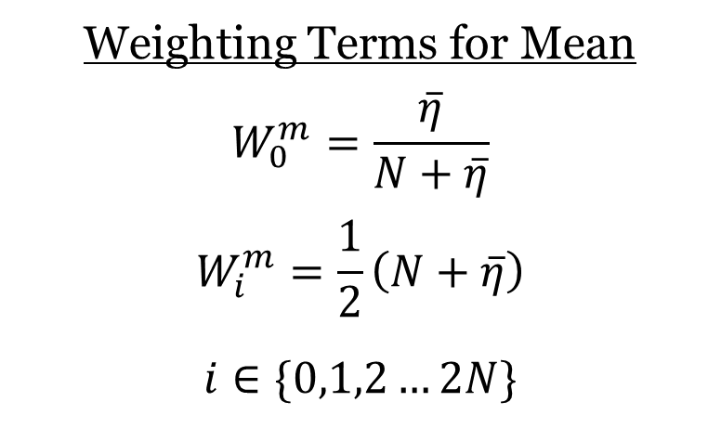
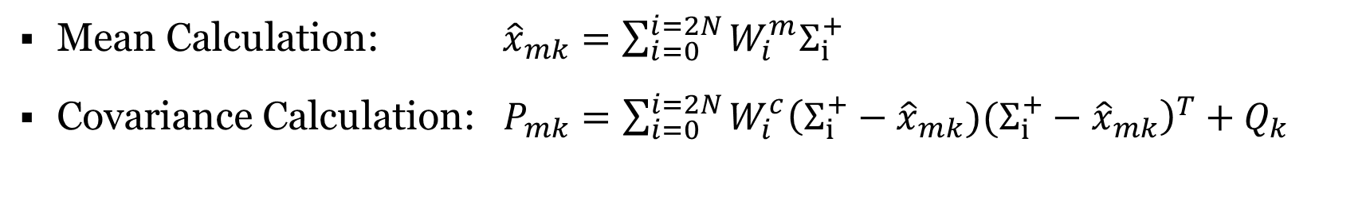
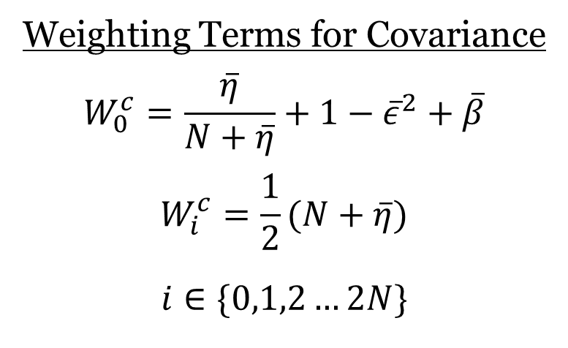
Prediction: Mean and Covariance Calculation
Weighting Terms for Mean
$$W_{0}^{m}=\frac{\overline{η}}{N+\overline{η}}$$
$$W_{i}^{m}=\frac{1}{2}\left(N+\overline{η}\right)$$
$i∈\{0,1,2…2N\}$
Weighting Terms for Covariance
$$W_{0}^{c}=\frac{\overline{η}}{N+\overline{η}}+1−{\overline{ε}}^{2}+\overline{β}$$
$$W_{i}^{c}=\frac{1}{2}(N+\overline{η})$$
$i∈\{0,1,2…2N\}$
Mean Calculation: ${\hat{x}}_{mk}=\sum_{i=0}^{i=2N}{W_{i}^{m}Σ_{i}^{+}}$
Covariance Calculation: $P_{mk}=\sum_{i=0}^{i=2N}{{W_{i}^{c}{\left(Σ_{i}^{+}−{\hat{x}}_{mk})(Σ_{i}^{+}−{\hat{x}}_{mk}\right)}^{T}+Q}_{k}}$

Slide 12
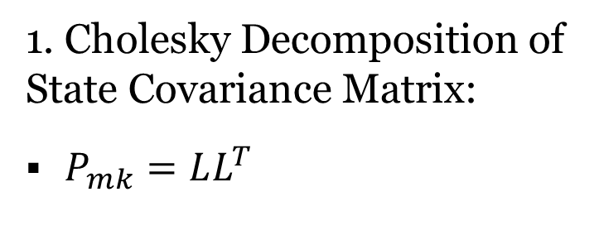
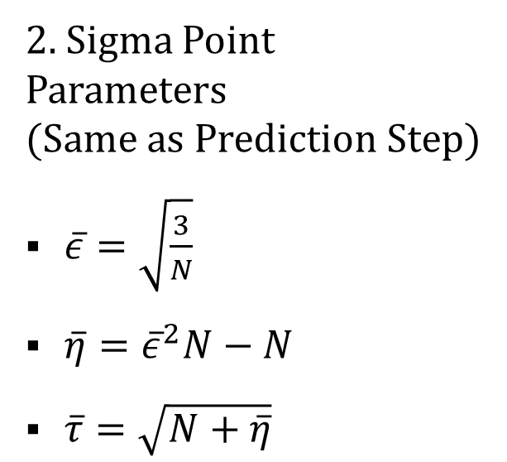
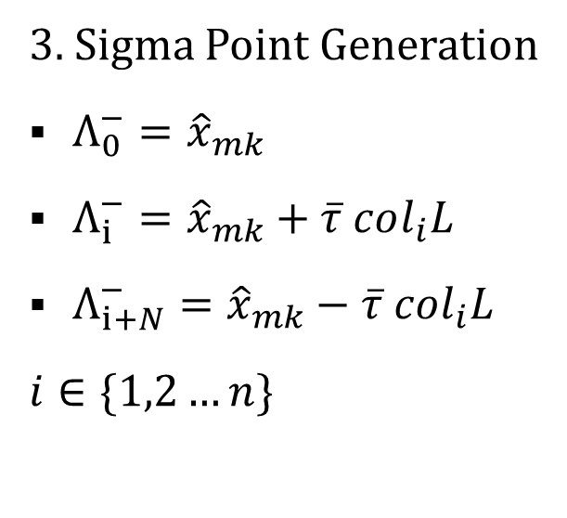
Correction: Sigma Point Generation
Generate another 2N+1 sigma points (where N = Length of State Vector)
1. Cholesky Decomposition of State Covariance Matrix:
$P_{mk}=LL^{T}$
2. Sigma Point Parameters (Same as Prediction Step)
$\overline{ε}=\sqrt{\frac{3}{N}}$
$\overline{η}={\overline{ε}}^{2}N−N$
$\overline{τ}=\sqrt{N+\overline{η}}$
3. Sigma Point Generation
$Λ_{0}^{−}={\hat{x}}_{mk}$
$Λ_{i}^{−}={\hat{x}}_{mk}+\overline{τ} col_{i}L$
$Λ_{i+N}^{−}={\hat{x}}_{mk}−\overline{τ} col_{i}L$
$i∈\{1,2…n\}$

Slide 13
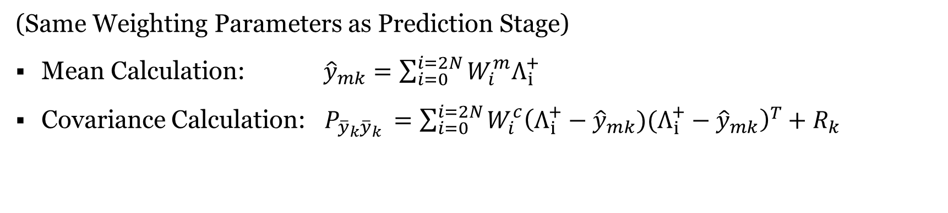
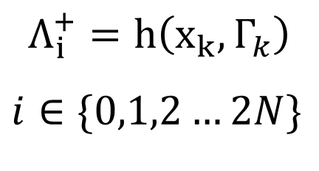
Correction: Propagate Sigma Points + Mean + Covariance
$$Λ_{i}^{+}=h\left(x_{k},Γ_{k}\right)$$
$i∈\{0,1,2…2N\}$
(Same Weighting Parameters as Prediction Stage)
Mean Calculation: ${\hat{y}}_{mk}=\sum_{i=0}^{i=2N}{W_{i}^{m}Λ_{i}^{+}}$
Covariance Calculation: $P_{{\overline{y}}_{k}{\overline{y}}_{k} }=\sum_{i=0}^{i=2N}{{W_{i}^{c}{\left(Λ_{i}^{+}−{\hat{y}}_{mk})(Λ_{i}^{+}−{\hat{y}}_{mk}\right)}^{T}+R}_{k}}$

Slide 14
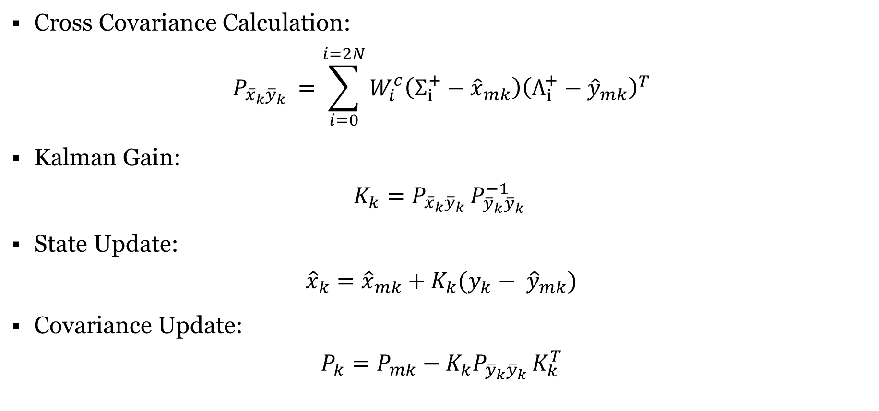
State and Covariance Update
Cross Covariance Calculation:
$$P_{{\overline{x}}_{k}{\overline{y}}_{k} }=\sum_{i=0}^{i=2N}{W_{i}^{c}\left(Σ_{i}^{+}−{\hat{x}}_{mk}\right){\left(Λ_{i}^{+}−{\hat{y}}_{mk}\right)}^{T}}$$
Kalman Gain:
$$K_{k}=P_{{\overline{x}}_{k}{\overline{y}}_{k} }P_{{\overline{y}}_{k}{\overline{y}}_{k} }^{−1}$$
State Update:
$${\hat{x}}_{k}={\hat{x}}_{mk}+K_{k}(y_{k}− {\hat{y}}_{mk})$$
Covariance Update:
$$P_{k}=P_{mk}−K_{k}P_{{\overline{y}}_{k}{\overline{y}}_{k} }K_{k}^{T}$$

Slide 15
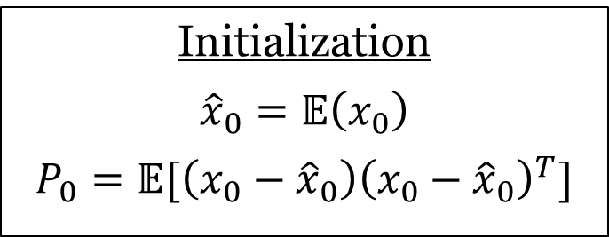
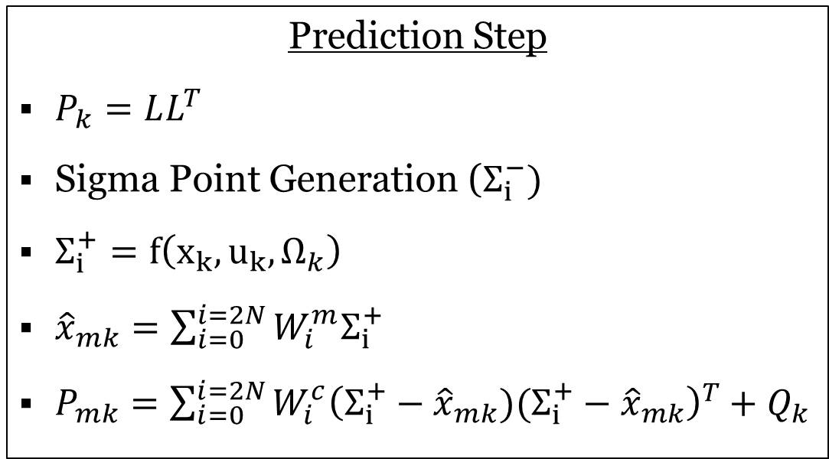
Unscented Kalman Filter (UKF) Summary Part 1
Initialization
$${\hat{x}}_{0}=𝔼\left(x_{0}\right)$$
$$P_{0}=𝔼[\left(x_{0}−{\hat{x}}_{0}\right){\left(x_{0}−{\hat{x}}_{0}\right)}^{T}]$$
Prediction Step
$P_{k}=LL^{T}$
Sigma Point Generation ($Σ_{i}^{−})$
$Σ_{i}^{+}=f\left(x_{k},u_{k},Ω_{k}\right)$
${\hat{x}}_{mk}=\sum_{i=0}^{i=2N}{W_{i}^{m}Σ_{i}^{+}}$
$P_{mk}=\sum_{i=0}^{i=2N}{{W_{i}^{c}{\left(Σ_{i}^{+}−{\hat{x}}_{mk})(Σ_{i}^{+}−{\hat{x}}_{mk}\right)}^{T}+Q}_{k}}$

Slide 16
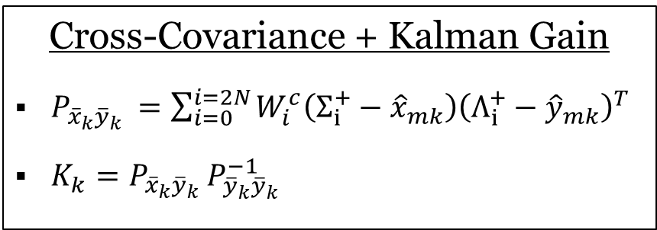
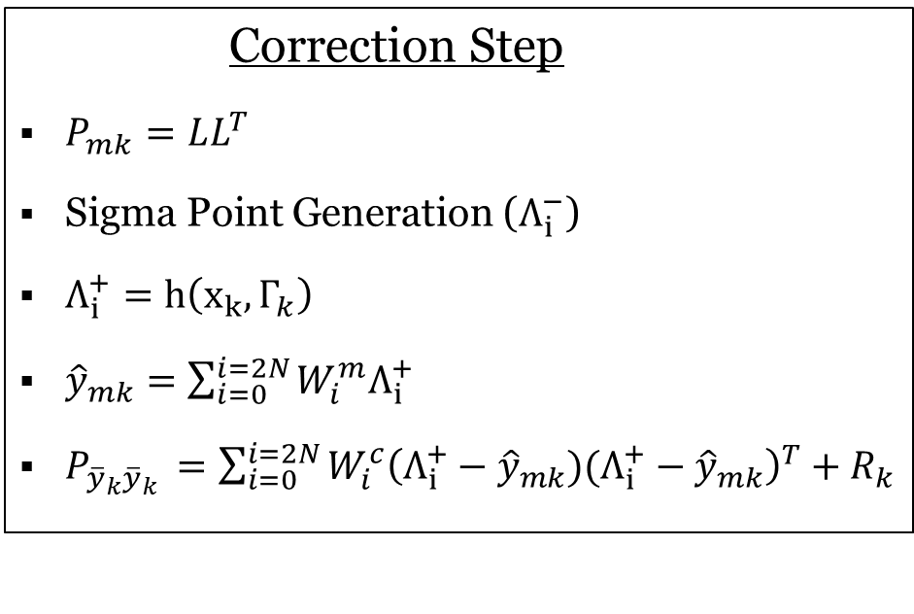
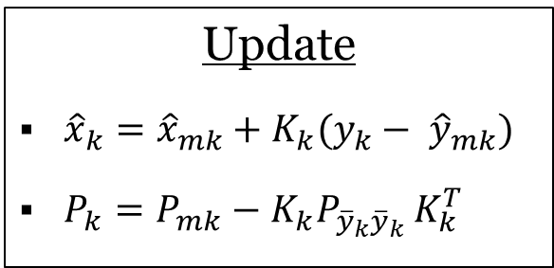
Unscented Kalman Filter (UKF) Summary Part 2
Correction Step
$P_{mk}=LL^{T}$
Sigma Point Generation ($Λ_{i}^{−}$)
$Λ_{i}^{+}=h\left(x_{k},Γ_{k}\right)$
${\hat{y}}_{mk}=\sum_{i=0}^{i=2N}{W_{i}^{m}Λ_{i}^{+}}$
$P_{{\overline{y}}_{k}{\overline{y}}_{k} }=\sum_{i=0}^{i=2N}{{W_{i}^{c}{\left(Λ_{i}^{+}−{\hat{y}}_{mk})(Λ_{i}^{+}−{\hat{y}}_{mk}\right)}^{T}+R}_{k}}$
Cross-Covariance + Kalman Gain
$P_{{\overline{x}}_{k}{\overline{y}}_{k} }=\sum_{i=0}^{i=2N}{W_{i}^{c}\left(Σ_{i}^{+}−{\hat{x}}_{mk}\right){\left(Λ_{i}^{+}−{\hat{y}}_{mk}\right)}^{T}}$
$K_{k}=P_{{\overline{x}}_{k}{\overline{y}}_{k} }P_{{\overline{y}}_{k}{\overline{y}}_{k} }^{−1}$
Update
${\hat{x}}_{k}={\hat{x}}_{mk}+K_{k}(y_{k}− {\hat{y}}_{mk})$
$P_{k}=P_{mk}−K_{k}P_{{\overline{y}}_{k}{\overline{y}}_{k} }K_{k}^{T}$

Slide 17
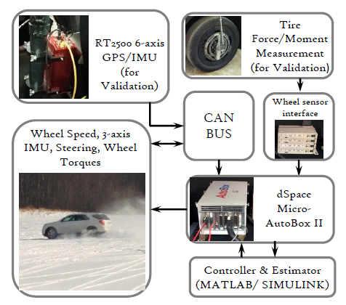

Experimental Test Data
Longitudinal Acceleration (X-Direction)
Lateral Acceleration (Y-Direction)
Yaw Rate
Wheel Speeds
Wheel Torques

Slide 18
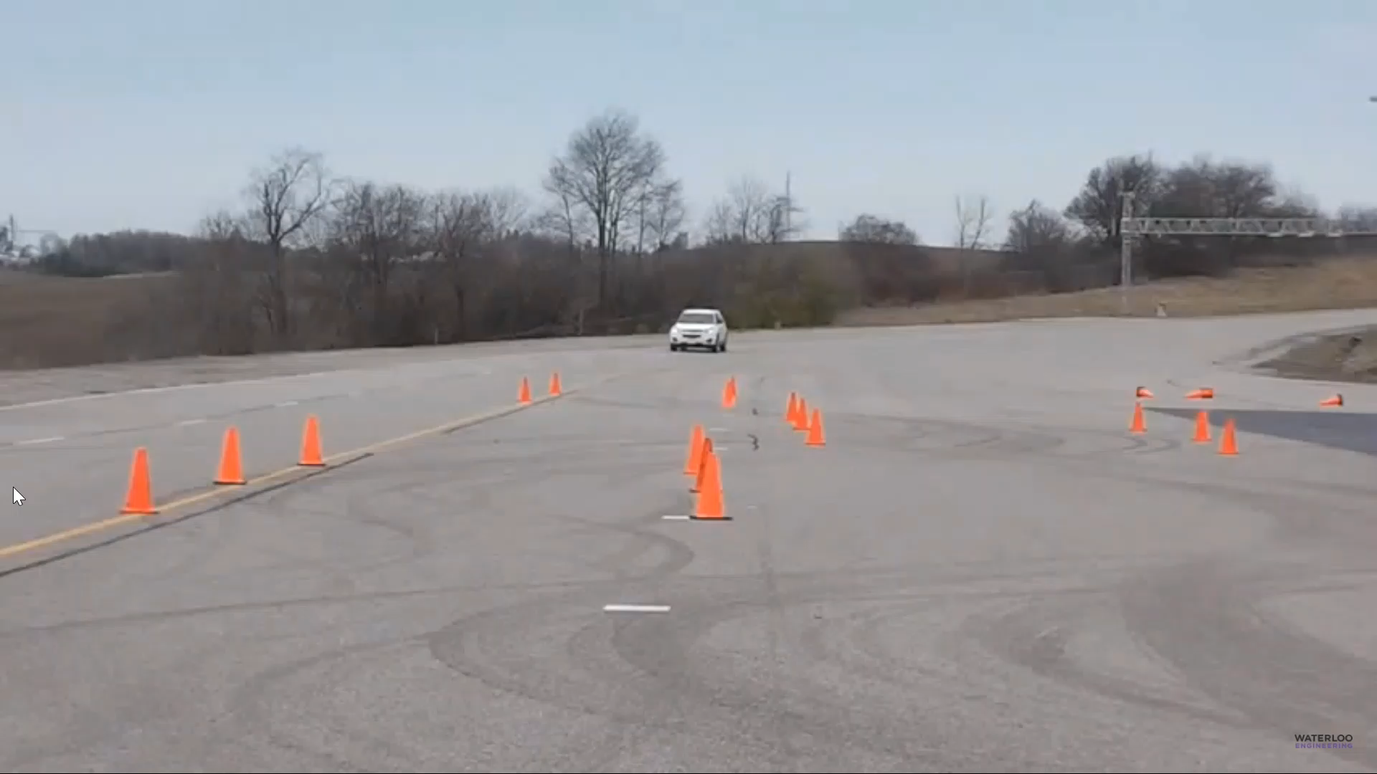
Harsh Lane Change Maneuver

Slide 19
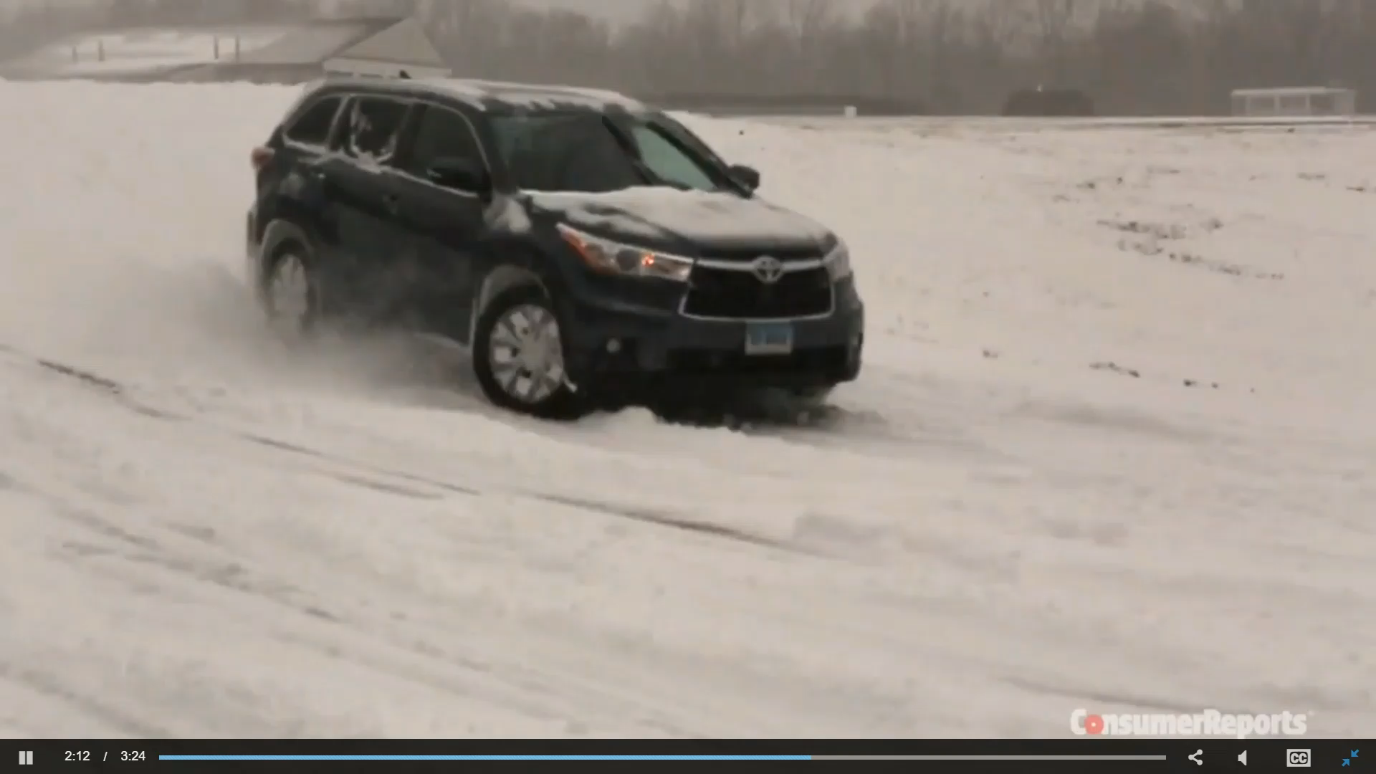
Harsh Steering Maneuver on Icy Road to Packed Snow

Slide 20
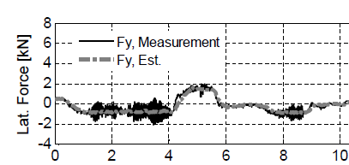
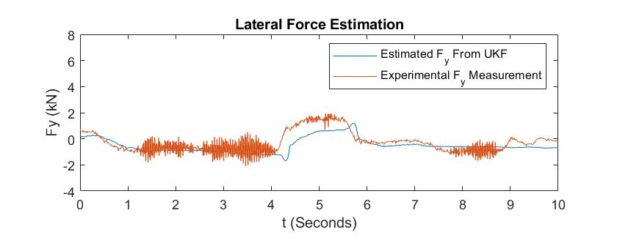
Simulation Results Summary
Paper Results (Figure 8)
Simulation Results (MATLAB)

Slide 21
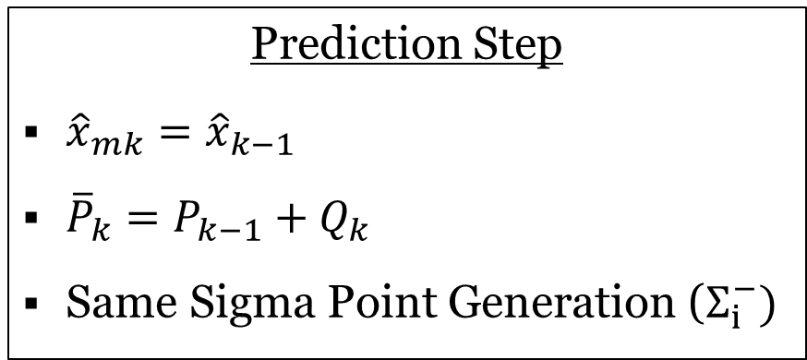
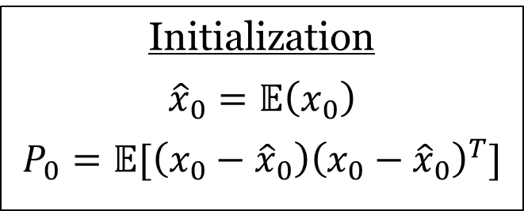
Parameter Estimation Problem
Implementation is a modified version of the state estimation problem presented since no dynamic model with forces are developed in the paper
Initialization
$${\hat{x}}_{0}=𝔼\left(x_{0}\right)$$
$$P_{0}=𝔼[\left(x_{0}−{\hat{x}}_{0}\right){\left(x_{0}−{\hat{x}}_{0}\right)}^{T}]$$
Prediction Step
${\hat{x}}_{mk}={\hat{x}}_{k−1}$
${\overline{P}}_{k}=P_{k−1}+Q_{k}$
Same Sigma Point Generation ($Σ_{i}^{−})$

Slide 22
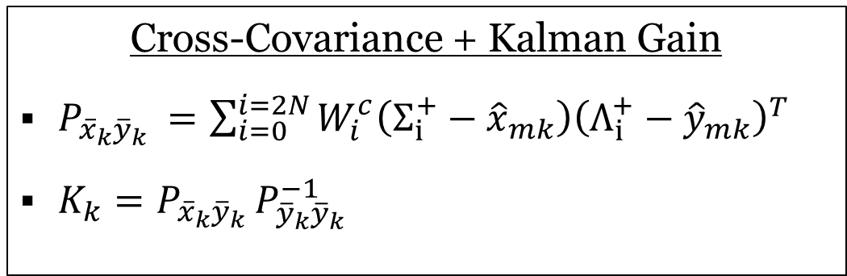
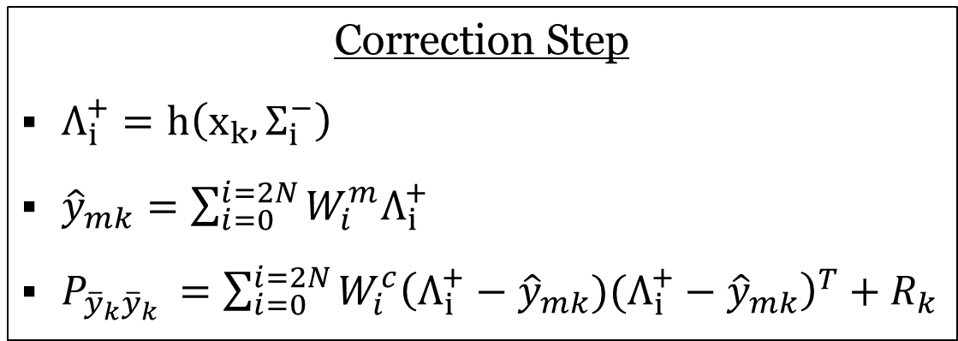
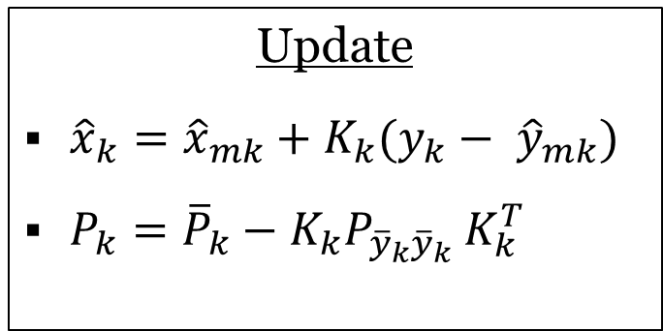
Parameter Estimation Problem
Correction Step
$Λ_{i}^{+}=h\left(x_{k},Σ_{i}^{−}\right)$
${\hat{y}}_{mk}=\sum_{i=0}^{i=2N}{W_{i}^{m}Λ_{i}^{+}}$
$P_{{\overline{y}}_{k}{\overline{y}}_{k} }=\sum_{i=0}^{i=2N}{{W_{i}^{c}{\left(Λ_{i}^{+}−{\hat{y}}_{mk})(Λ_{i}^{+}−{\hat{y}}_{mk}\right)}^{T}+R}_{k}}$
Cross-Covariance + Kalman Gain
$P_{{\overline{x}}_{k}{\overline{y}}_{k} }=\sum_{i=0}^{i=2N}{W_{i}^{c}\left(Σ_{i}^{+}−{\hat{x}}_{mk}\right){\left(Λ_{i}^{+}−{\hat{y}}_{mk}\right)}^{T}}$
$K_{k}=P_{{\overline{x}}_{k}{\overline{y}}_{k} }P_{{\overline{y}}_{k}{\overline{y}}_{k} }^{−1}$
Update
${\hat{x}}_{k}={\hat{x}}_{mk}+K_{k}(y_{k}− {\hat{y}}_{mk})$
$P_{k}={\overline{P}}_{k}−K_{k}P_{{\overline{y}}_{k}{\overline{y}}_{k} }K_{k}^{T}$

Slide 23
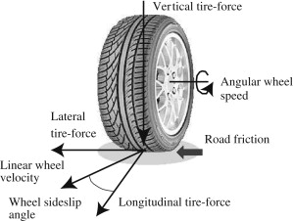
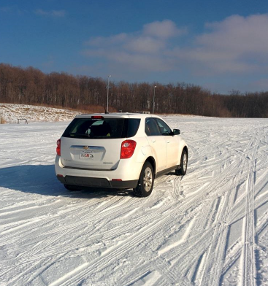
Conclusion
Lateral Force Estimation using Unscented Kalman Filter (UKF)
UKF

Slide 24
Corner-based Estimation of Tire Forces

Slide 25
Supplementary Slides

Slide 26
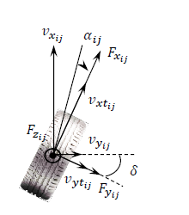
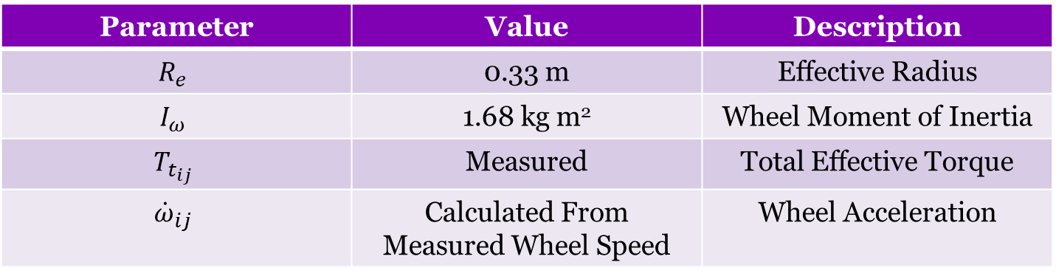
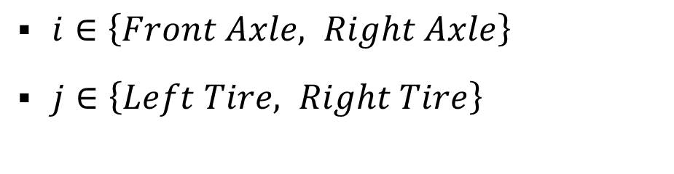

Longitudinal Force $(F_{x})$
$$F_{xij}=\frac{1}{R_{e}}\left(T_{t_{ij}}−I_{ω}{\dot{ω}}_{ij}\right)$$
$i∈\left\{Front Axle, Right Axle\right\}$
$j∈\left\{Left Tire, Right Tire\right\}$
Parameter | Value | Description
$$R_{e}$$ | 0.33 m | Effective Radius
$$I_{ω}$$ | 1.68 kg m² | Wheel Moment of Inertia
$$T_{t_{ij}}$$ | Measured | Total Effective Torque
$${\dot{ω}}_{ij}$$ | Calculated From Measured Wheel Speed | Wheel Acceleration

Slide 27
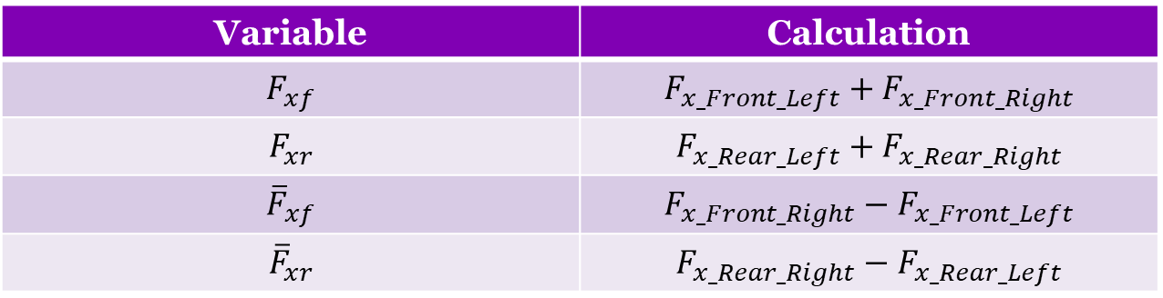
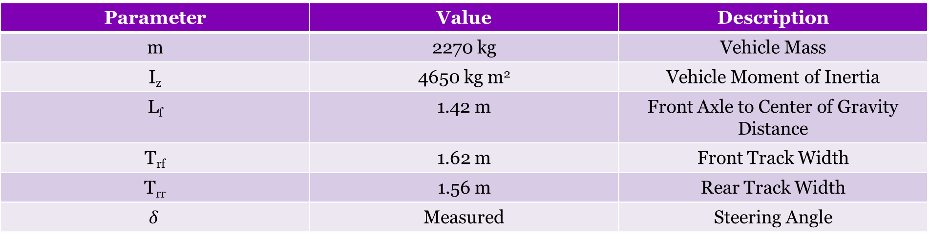
Other Vehicle Parameters
Parameter | Value | Description
m | 2270 kg | Vehicle Mass
I_{z} | 4650 kg m² | Vehicle Moment of Inertia
L_{f} | 1.42 m | Front Axle to Center of Gravity Distance
T_{rf} | 1.62 m | Front Track Width
T_{rr} | 1.56 m | Rear Track Width
$$δ$$ | Measured | Steering Angle
Variable | Calculation
$$F_{xf}$$ | $$F_{x_Front_Left}+F_{x_Front_Right}$$
$$F_{xr}$$ | $$F_{x_Rear_Left}+F_{x_Rear_Right}$$
$${\overline{F}}_{xf}$$ | $$F_{x_Front_Right}−F_{x_Front_Left}$$
$${\overline{F}}_{xr}$$ | $$F_{x_Rear_Right}−F_{x_Rear_Left}$$

Slide 28
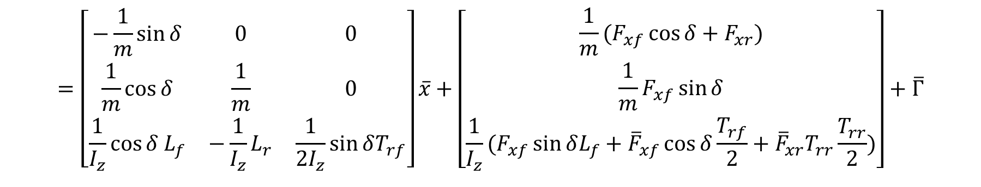

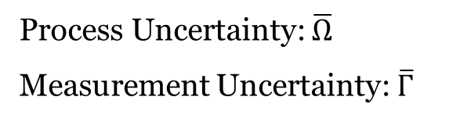


System and Measurement Models
$$\overline{x}=\overline{A}\overline{x}+\overline{Ω}$$
Process Uncertainty: $\overline{Ω}$
Measurement Uncertainty: $\overline{Γ}$
$$\overline{y}=\overline{C}(δ)\overline{x}+\overline{u}+\overline{Γ}$$
$$=\left[\begin{matrix}−\frac{1}{m}\sin{δ} & 0 & 0 \\ \frac{1}{m}\cos{δ} & \frac{1}{m} & 0 \\ \frac{1}{I_{z}}\cos{δ L_{f}} & −\frac{1}{I_{z}}L_{r} & \frac{1}{2I_{z}}\sin{δT_{rf}}\end{matrix}\right]\overline{x}+\left[\begin{matrix}\frac{1}{m}(F_{xf}\cos{δ+F_{xr}}) \\ \frac{1}{m}F_{xf}\sin{δ} \\ \frac{1}{I_{z}}(F_{xf}\sin{δL_{f}+{\overline{F}}_{xf}\cos{δ\frac{T_{rf}}{2}}+{\overline{F}}_{xr}T_{rr}\frac{T_{rr}}{2}})\end{matrix}\right]+\overline{Γ}$$
Where for each time step k:
$\overline{A}=0_{3x3}$
${\overline{Q}}_{k}=𝔼$ ${[\overline{Ω}}_{k}, {\overline{Ω}}_{k}^{T}]={0.13}^{2}I_{3x3}$
${\overline{R}}_{k}=𝔼$ ${[\overline{Γ}}_{k}, {\overline{Γ}}_{k}^{T}]={0.012}^{2}I_{3x3}$

Slide 29

Observability of the System
The observability matrix of the system is given by:
$O_{n}=\left[\begin{matrix}ξ_{1} \\ ξ_{2} \\ \begin{aligned}. \\ . \\ . \\ ξ_{n}\end{aligned}\end{matrix}\right]$ where $ξ_{1}=\overline{C}, ξ_{i+1}=ξ_{i}\overline{A}\left(t\right)+ \dot{ξ_{i}}$
Note that rank ($O_{n}$) = 3 for the operating regions of the steering angle and its time derivatives except when $δ=0$ or $kπ$for $k∈\text{ℤ}$
For $δ=0$, the lateral force is equal to zero
Situations of $δ=kπ$ do not occur since the maximum value of the steering angle is much less than $δ=\frac{π}{2}$ on commercial vehicles
Therefore the system is observable, which is a sufficient condition for the implementation of an optimal variance estimator (Such as a Kalman estimator)

Slide 30
General Comparison Between State Estimators
State Estimator | Model | Computational Cost
Kalman Filter (KF) | Linear | Low
Extended Kalman Filter (EKF) | Locally Linear | Low (For analytically computed Jacobians) Medium (For numerically computed Jacobians)
Unscented Kalman Filter (UKF) | Nonlinear | Medium
Particle Filter (PF) | Nonlinear | High

Slide 31

Disclaimer on Available Experimental Data
Note that the experimental data used to generate Figures 6 and 7 were not available from the main author of the paper (Ehsan Hashemi)
However, data for the longitudinal forces was still available for Figure 8 (Harsh Steering on Icy Road to Packed Snow)

Slide 32

Measurement Equipment
RT2500 6-Axis GPS
IMU
Wheel Speed Sensors
CAN-bus for communication
Sampling Frequency of 200 Hz

Slide 33



Acceleration Measurements
Corrected Acceleration Measurements:
$${ \overline{a}}_{x}=a_{x}−gsin\left(θ_{v}+θ_{r}\right)$$
$${ \overline{a}}_{y}=a_{y}−gsin(φ_{v}+φ_{r})$$
Pitch Angle
Roll Angle
Note: Test data collected for Figure 8 was conducted on a flat surface (Pitch, Roll, Road Grade, and Bank Angles are all Zero) ${→ \overline{a}}_{x}=a_{x}$ and ${\overline{a}}_{y}=a_{y}$
Road Grade Angle
Bank Angle

Slide 34

Extensions Beyond Lateral Force Estimation
The developed lateral tire force estimator is utilized in a corner-based approach for vehicle velocity estimation later in the paper
The velocity estimation method also requires a road grade estimator developed in a previous paper, as well as a vertical tire force estimator developed following the lateral force estimation
Road condition classification is another result from the overall corner-based estimation approach independent from lateral force estimation

Slide 35
References
Images
Dollar Sign Clipart [Digital image]. (2019). Retrieved April 11, 2021, from http://clipart-library.com/clip-art/25-259936_ecmhva-dollar-sign-png-transparent.htm
Ehsan Hashemi, Mohammad Pirani, Amir Khajepour, Alireza Kasaiezadeh, Shih-Ken Chen, Bakhtiar Litkouhi, Corner-based estimation of tire forces and vehicle velocities robust to road conditions, Control Engineering Practice, Volume 61, 2017, Pages 28-40, ISSN 0967-0661, https://doi.org/10.1016/j.conengprac.2017.01.009.
Guillaume Baffet, Ali Charara, Daniel Lechner, Estimation of vehicle sideslip, tire force and wheel cornering stiffness, Control Engineering Practice, Volume 17, Issue 11, 2009, Pages 1255-1264, ISSN 0967-0661, https://doi.org/10.1016/j.conengprac.2009.05.005.
H. Fang, N. Tian, Y. Wang, M. Zhou and M. A. Haile, "Nonlinear Bayesian estimation: from Kalman filtering to a broader horizon," in IEEE/CAA Journal of Automatica Sinica, vol. 5, no. 2, pp. 401-417, Mar. 2018, doi: 10.1109/JAS.2017.7510808.
Kelly, J. (Director). (2021). An alternative to the ekf - The Unscented Kalman filter - Module 2: State estimation - linear and Nonlinear Kalman filters [Video file]. Retrieved April 11, 2021, from https://www.coursera.org/lecture/state-estimation-localization-self-driving-cars/lesson-6-an-alternative-to-the-ekf-the-unscented-kalman-filter-voRRb
Khajepour, A. (2021). Mechatronic Vehicle Systems Lab [Digital image]. Retrieved April 11, 2021, from https://uwaterloo.ca/mechatronic-vehicle-systems-lab/
Namm, M. (2020). ADAS (Advanced Driver Assistance Systems) [Digital image]. Retrieved April 11, 2021, from https://learn.sonicelectronix.com/advanced-driver-assistance-systems/
R. (2019, October 19). The 10 Best And Worst Car Brands In The Automotive Industry [Digital image]. Retrieved April 11, 2021, from https://autowise.com/car-brands/
Resources
Ehsan Hashemi (2017). Full Vehicle State Estimation Using a Holistic Corner-based Approach. UWSpace. http://hdl.handle.net/10012/11744
Ehsan Hashemi, Mohammad Pirani, Amir Khajepour, Alireza Kasaiezadeh, Shih-Ken Chen, Bakhtiar Litkouhi, Corner-based estimation of tire forces and vehicle velocities robust to road conditions, Control Engineering Practice, Volume 61, 2017, Pages 28-40, ISSN 0967-0661, https://doi.org/10.1016/j.conengprac.2017.01.009.
Kelly, J. (Director). (2021). An alternative to the ekf - The Unscented Kalman filter - Module 2: State estimation - linear and Nonlinear Kalman filters [Video file]. Retrieved April 11, 2021, from https://www.coursera.org/lecture/state-estimation-localization-self-driving-cars/lesson-6-an-alternative-to-the-ekf-the-unscented-kalman-filter-voRRb
Videos
Do you really need awd in the snow? [Video file]. (2015, September 15). Retrieved April 11, 2021, from https://www.consumerreports.org/cro/magazine/2015/09/do-you-really-need-awd-in-the-snow/index.htm
Khajepour, A. (Director). (2021, February 08). Holistic vehicle control [Video file]. Retrieved April 11, 2021, from https://uwaterloo.ca/mechatronic-vehicle-systems-lab/research/vehicle-control-systems/holistic-vehicle-control
Robinson, D. (Director). (2016, October 17). How to correct a slide on an icy road (and how to prevent them) - Winter driving education [Video file]. Retrieved April 11, 2021, from https://www.youtube.com/watch?v=TZQXuWzBC18

